Slide 1
HPV preliminary diagnosis through complete blood sample test, a machine learning approach
Alejandro López Vázquez
Tecnológico de Monterrey
School of Engineering and Science

Slide 2
ABSTRACT
Cervical Cancer is a deadly desease which causes millions of deads yearly world wide. The main goal for this project was to develop a model which can pre-diagnose Human Papiloma Virus (HPV) with certain accuracy bases on a complete blood laboratory exam.
Key words:
Machine learning.
HPV.
Early detection.
PCR.
Neural Network

Slide 3
TABLE OF CONTENTS
01
02
03
INTRODUCTION
METHOD & DATA
RESULTS

Slide 4
TABLE OF CONTENTS
04
05
DISCUSSION
CONCLUSION

Slide 5
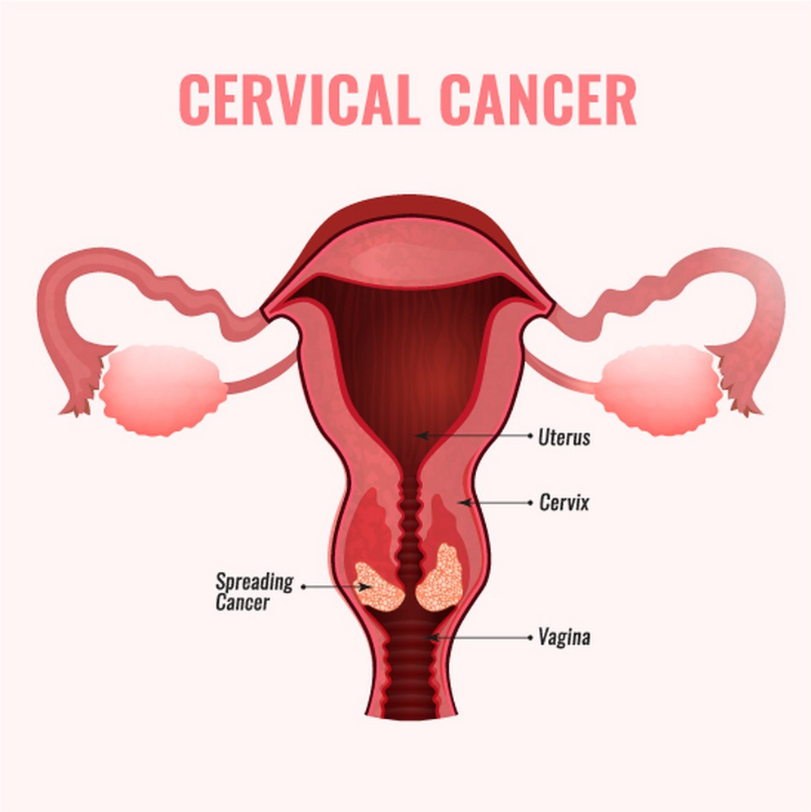
INTRODUCTION
Cervical cancer is the third main cause of dead for women in Mexico. Cervical cancer is caused by some of the many HPV existing types and each can be more or less aggressive, types 16 and 18 being the most dangerous.

Slide 6
The research questions
1.- Can HPV be dectected through the use of machine learnig with data previously obtained of the patient?

Slide 7
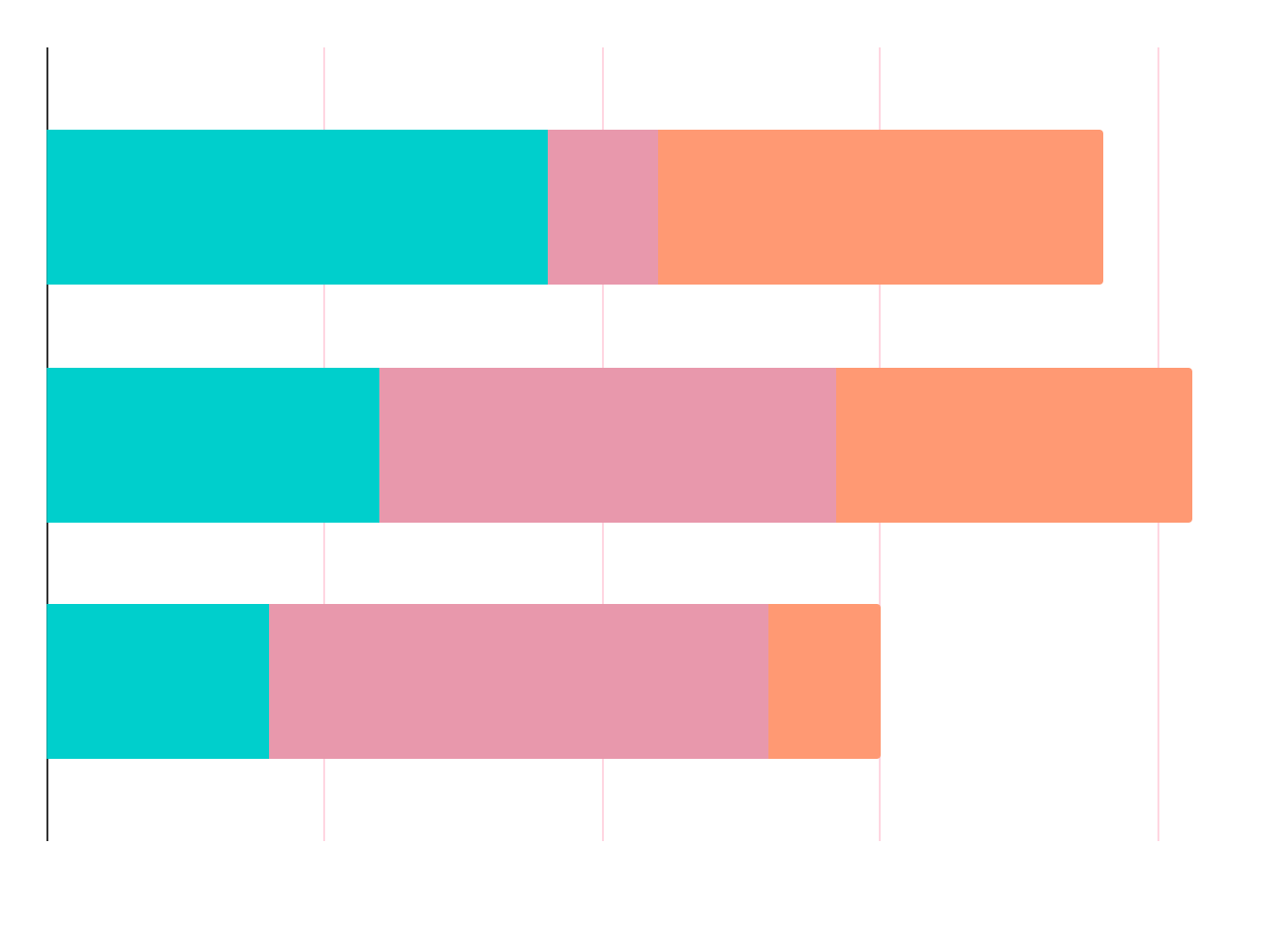
The research questions
1.- Can HPV be pre-diagnosed based on a complete blood sample test?

Slide 8
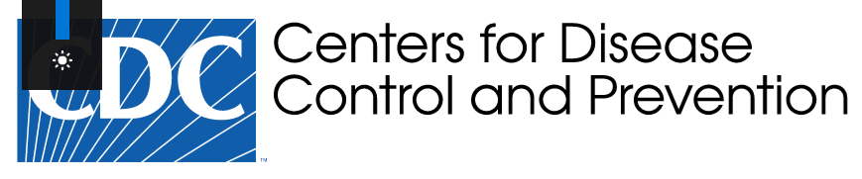
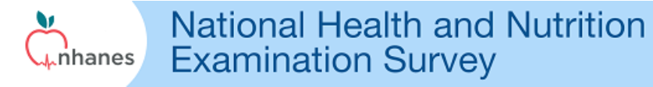
The Data
Source
The data was obtained from the UU.SS CDC from a the page of the National Health and Nutrition Examination Survey (NHANES). And we obtained the data specifically of labortory data from the Complete Blood Count with 5-part Differential - Whole Blood and Human Papillomavirus (HPV) DNA - Vaginal Swab from year 2003 to 2016

Slide 9
Complete Blood Count with 5-part Differential - Whole Blood
SEQN - Respondent sequence number
LBXWBCSI - White blood cell count (1000 cells/uL)
LBXLYPCT - Lymphocyte percent (%)
LBXMOPCT - Monocyte percent (%)
LBXNEPCT - Segmented neutrophils percent (%)
LBXEOPCT - Eosinophils percent (%)
LBXBAPCT - Basophils percent (%)
LBDLYMNO - Lymphocyte number (1000 cells/uL)
LBDMONO - Monocyte number (1000 cells/uL)
LBDNENO - Segmented neutrophils num (1000 cell/uL)

Slide 10
Complete Blood Count with 5-part Differential - Whole Blood
LBDEONO - Eosinophils number (1000 cells/uL)
LBDBANO - Basophils number (1000 cells/uL)
LBXRBCSI - Red blood cell count (million cells/uL)
LBXHGB - Hemoglobin (g/dL)
LBXHCT - Hematocrit (%)
LBXMCVSI - Mean cell volume (fL)
LBXMCHSI - Mean cell hemoglobin (pg)
LBXMC - Mean Cell Hgb Conc. (g/dL)
LBXRDW - Red cell distribution width (%)
LBXPLTSI - Platelet count (1000 cells/uL)
LBXMPSI - Mean platelet volume (fL)
LBXNRBC - Nucleated red blood cells

Slide 11
Human Papillomavirus (HPV) DNA - Vaginal Swab: Roche Linear Array
SEQN - Respondent sequence number
LBDRPCR - Roche HPV linear array summary result
LBDRPCR - The HPV PCR Summary variable indicates if at least one type is positive (LBDRPCR=1); the sample is negative (LBDRPCR=2); the sample is inadequate (LBDRPCR=3); or the sample is missing (LBDRPCR=.)

Slide 12
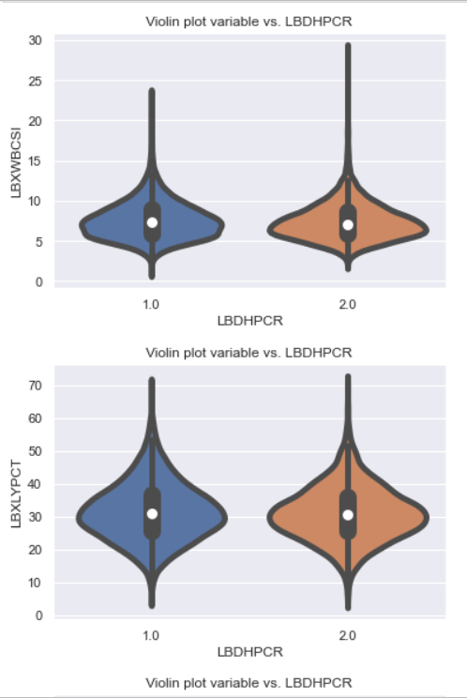
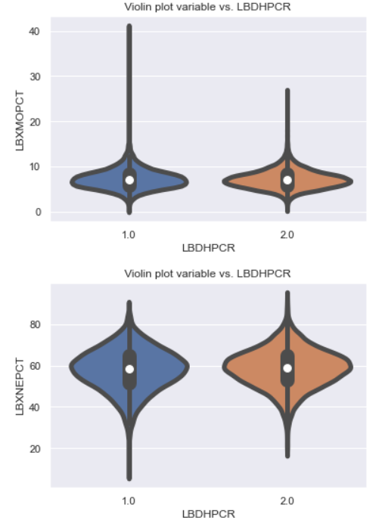
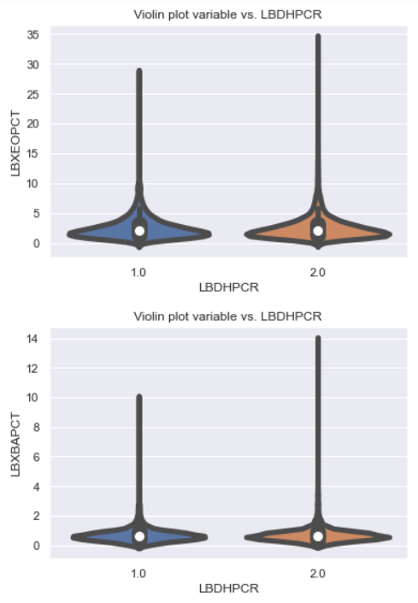
Data Understanding

Slide 13
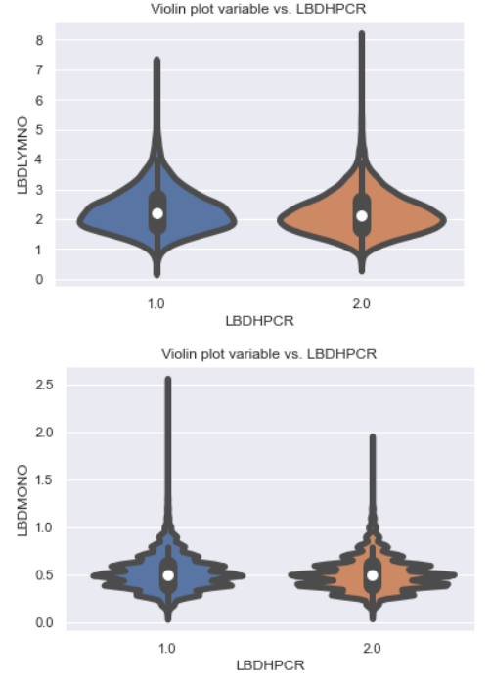
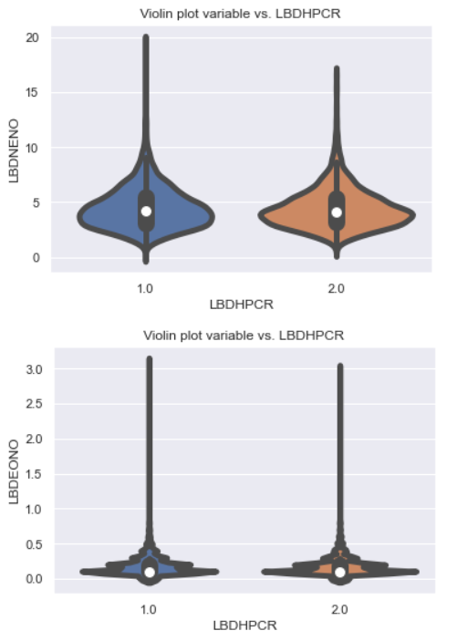
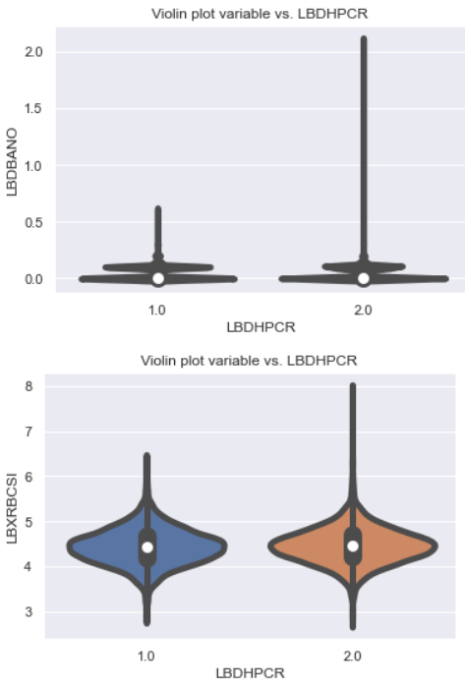
Data Understanding

Slide 14
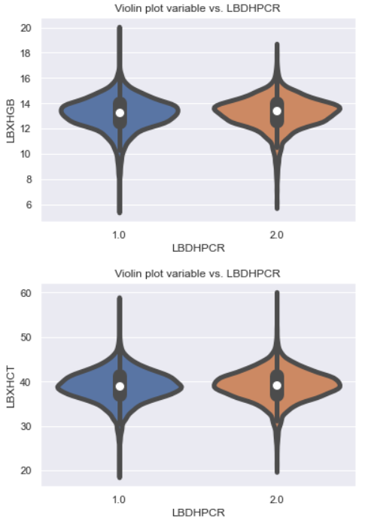
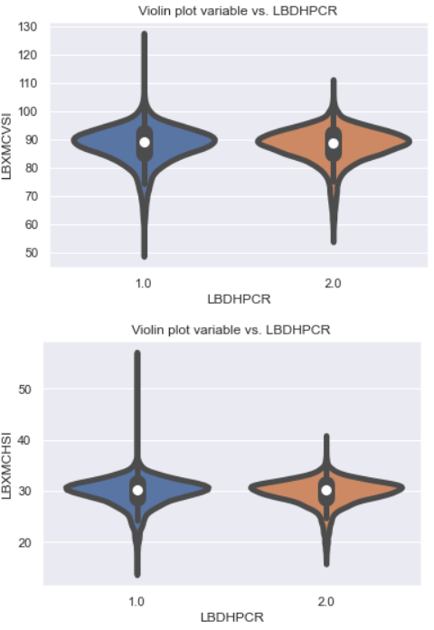
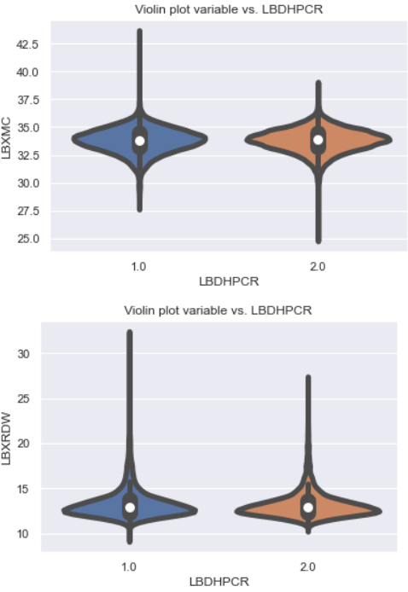
Data Understanding

Slide 15
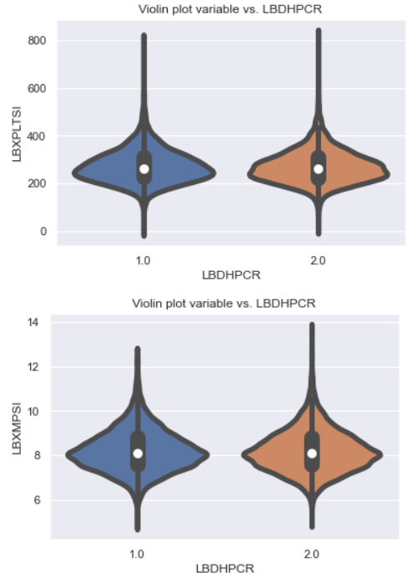
Data Understanding

Slide 16
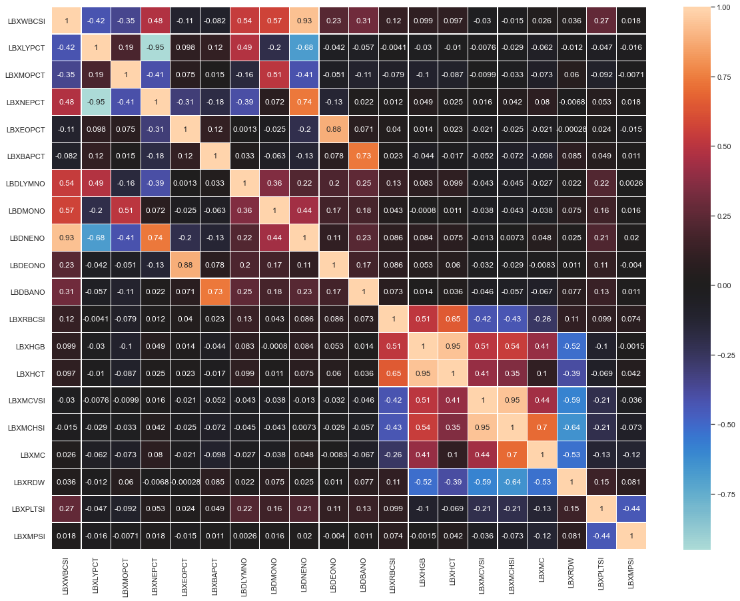
Correlation Matrix Removed Variables
LBDEONO
LBDNENO
LBXNEPCT
LBXHCT
LBXMCHSI

Slide 17
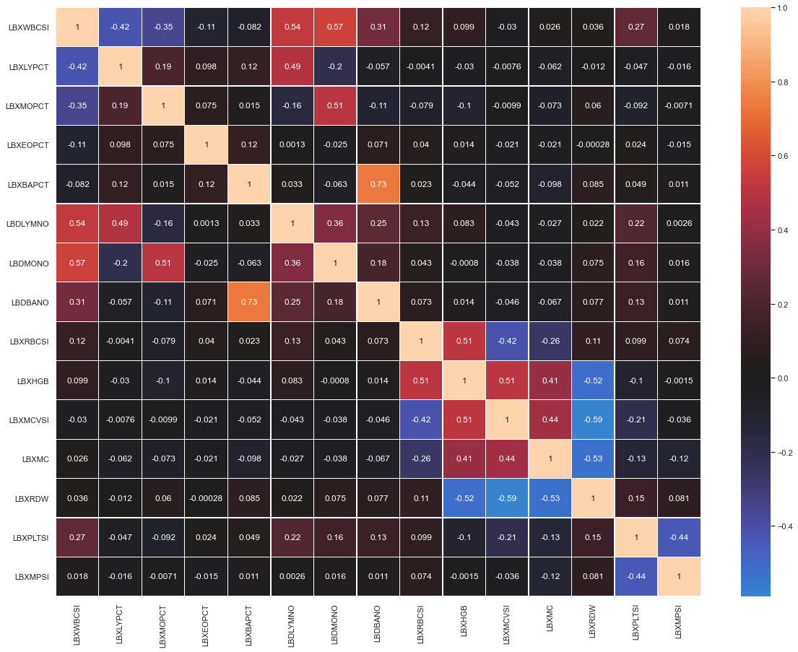

Slide 18
Data preparation
Variable normalization
All the variables are continuos so in order to prepare the data a normalization conversion was performed in oorder to place them between the values of 0 and 1
Train and test splitting
The data was divided into target and predictors, and for both of them a division for a training an a test set was performed with a 75% and a 25% of the data respectively

Slide 19
Models
Decision Tree
Logistic Regression
Naive Bayes
K neares Neighbors
Random Forest
Multi-Layer Perception

Slide 20
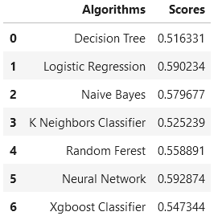
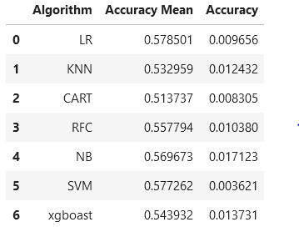
Results

Slide 21
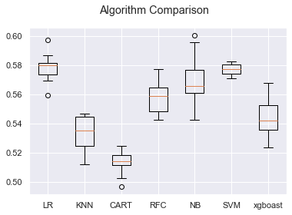
Comparisson Boxplot

Slide 22
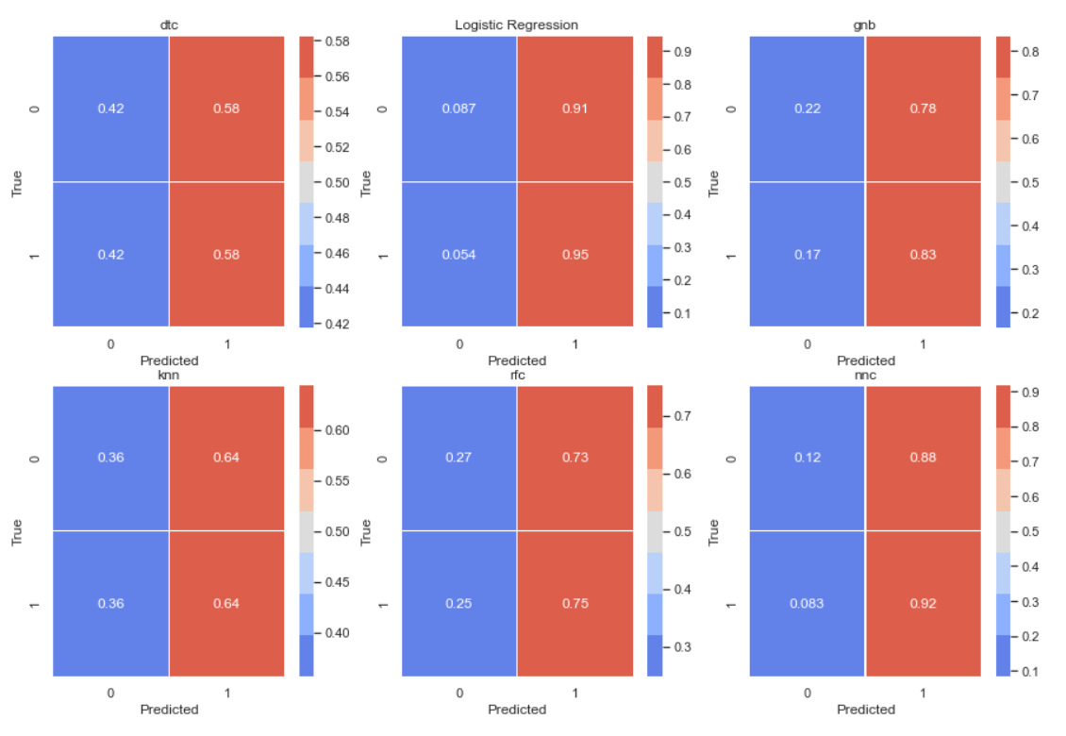
Correlation matrixes

Slide 23
Discussion
The propossed models cannot preddict with Good accuaricy the presence of HPV with the complete blood laboratory results.

Slide 24
Conclusion
For future work:
There is still a lot of information in the NHANES page, including different laboratories or even quesionares filed by the patients
This model can be used also for other diseases uncluded in the same data set.
MUCH
DONE
THERE’S
TO BE

Slide 25


